Slide 1
Ecommerce Analysis

Slide 2

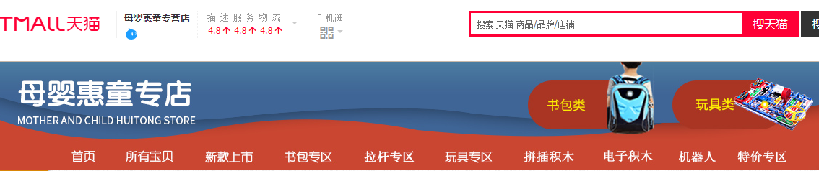


Alibaba Group Holding Limited is a Chinese multinational conglomerate holding company specializing in e-commerce, retail, Internet, and technology.

Slide 3
Data Introduction
Background:
TianMao online ecommerce store
2010 - 2019
Over 143,000 sales records
61 features (30 after cleaning)
Products includes:
Backpack, Electrical Puzzles, Toys
End Users:
Kindergarten
Preschool
Primary
Middle school
Customers:
Moms
Retail Store owners
Gift buyers

Slide 4

Data Clean
Missing data imputation:
CellPhone = AlipayAccount
Null ==> No (For note and messages)
Delete rows:
Duplicates
Exceptions (Shipping only orders)
Delete columns:
ContactPhone
StoreID
StoreName
DeliverNo
New columns:
Address ==> Province & City
OrderToPay(s)
PayToReceive(h)

Slide 5
Performance Comparison
Vs. Industrial Average
Vs. Top 10 Competitors
&
Suggested Solutions
(* part of data in this section acquired from different channels)
Notes:
Create more orders from the current customer
Increase purchase / customer

Slide 6
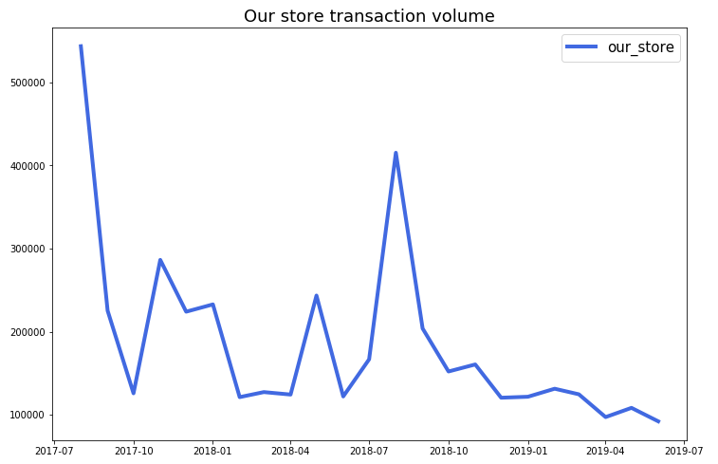
Our Store’s Transaction Volume from 2017- 2019
Transaction volume is decreasing,
especially in 2019
”

Slide 7
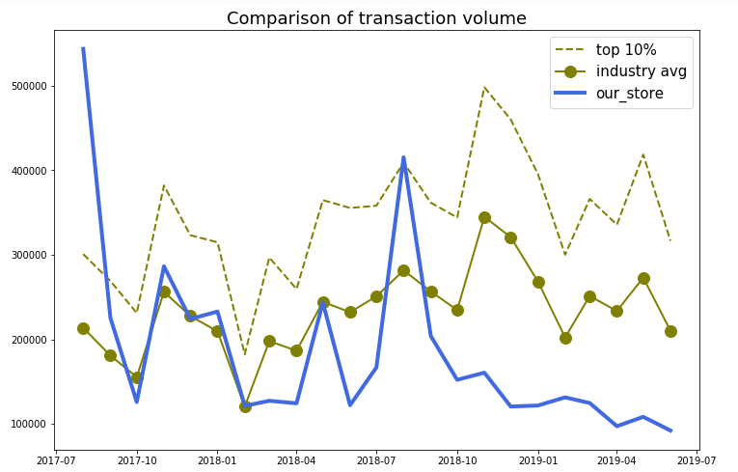
Comparison of Transaction Volume from 2017-2019
Slight upward trend of the industry
”

Slide 8
TOP ( AVG ) TXN Volume - My TXN Volume
GAP =
My TXN Volume

Slide 9
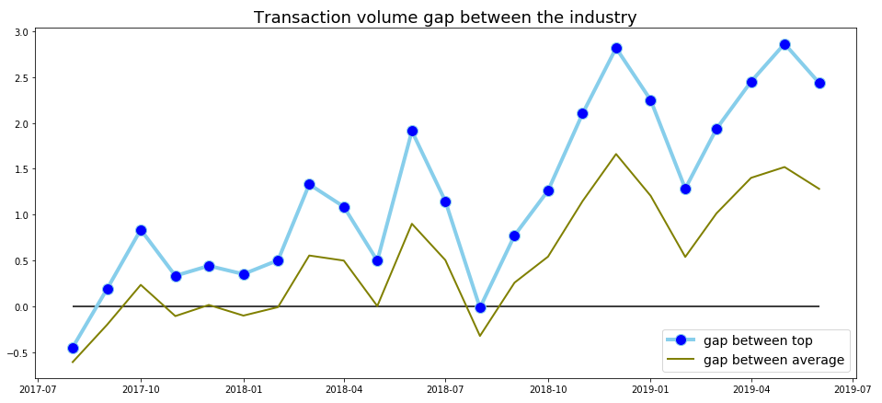

Slide 10
TXN Volume =
AVG TXN Value * Order Quantity
AVG TXN Value * Order Quantity

Slide 11
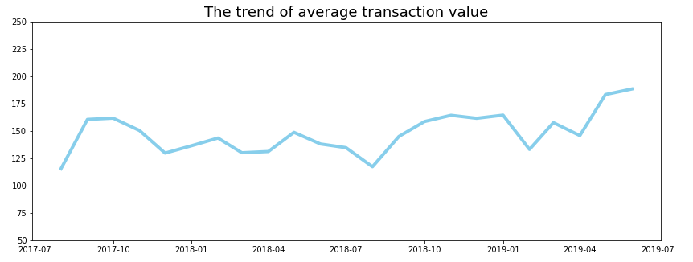
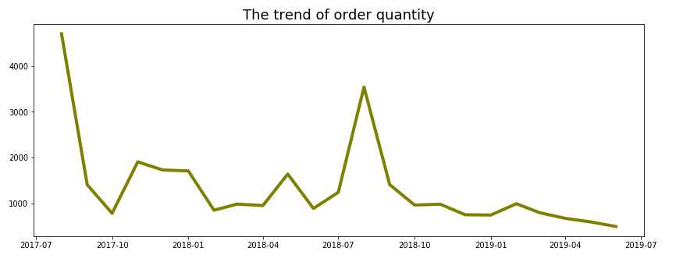
AVG TXN Value is stable
But Order Quantity decrease

Slide 12
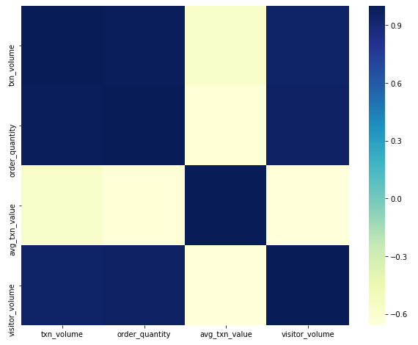

Order Quantity
Strong positive correlation with Transaction Volume and Visitor Volume
Negative correlation with Average Transaction Value

Slide 13
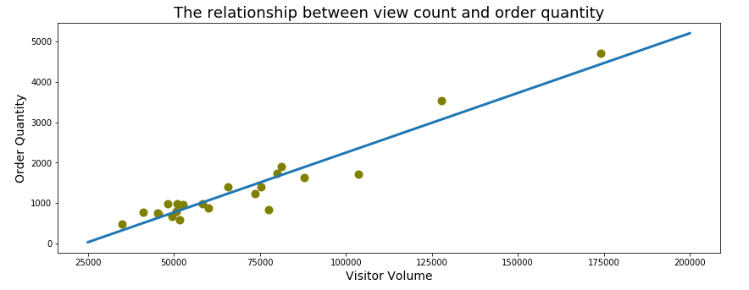
Two methods to increase order quantity
Increase visitor volume High Cost
Increase order quantity / visitor volume ( per visit order quantity)

Slide 14
Order Quantity
Customer Volume * Orders per Customer
=
Visit Volume
Visit Volume

Slide 15
Order Quantity
Customer Volume
Orders per Customer
=
*
Visit Volume
Visit Volume
Conversion rate

Slide 16
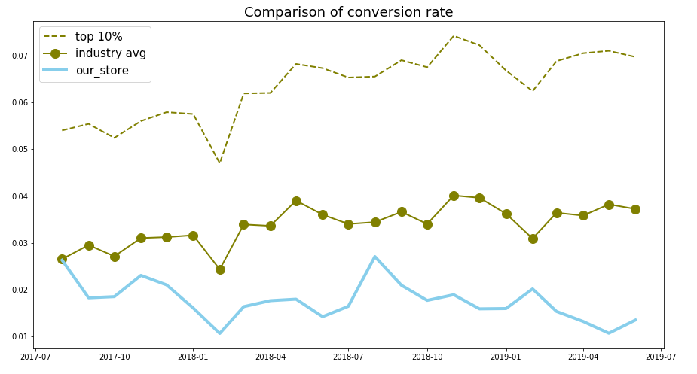
Comparison of Conversion Rate
Conversion rate is far behind the industry
”

Slide 17
TOP ( AVG ) CVR - My CVR
GAP =
My CVR

Slide 18
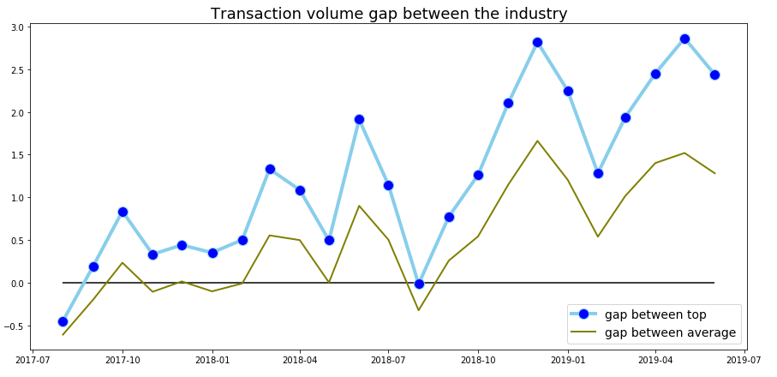
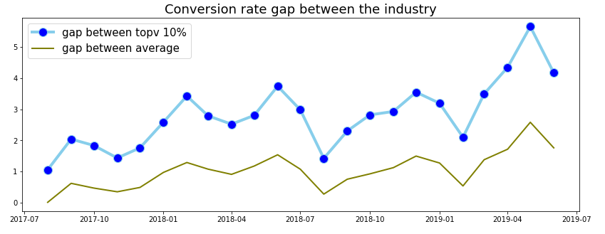
Transaction volume gap is in 3 times
The biggest conversion rate gap is more than 5 times

Slide 19
ΔTXN Volume
=
Visit Volume * AVG TXN Value
ΔCVN Rate
=
TXN Volume
Visit Volume * CVN Rate * AVG TXN Value
Take Agu 2017 as example:
ΔTXN Volume
=
174213 * 115.39 * 0.01(ΔCVN Rate)
=
201032.81

Slide 20
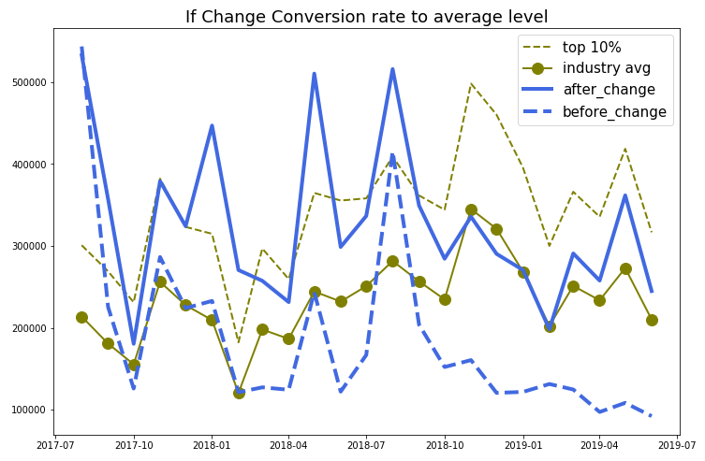
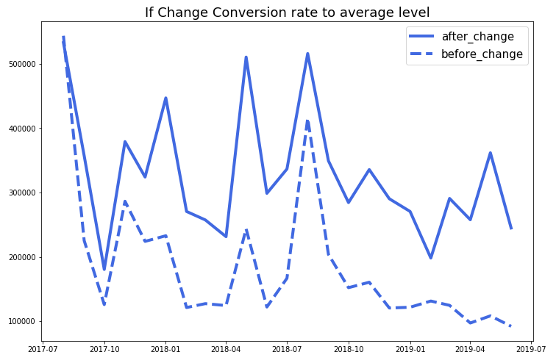
If we change our conversion rate to the industry average level:

Slide 21
2020 Store Plan Suggestion
Conversion Rate reach:
2018 Mean conversion rate + average gap between industry average level in 2018
1.76% + 1.62% = 3.38%
Profit may increase ( profit rate suppose to be 10% of the txn volume):
Profit Per Increase * Mean Gap Between AVG / 0.01 (2018)
= 193386.53
The budget of increasing cvn rate should be lower than 193386.53

Slide 22
Customer Retention
Notes:
Increase larger active customer body from accumulated customers. -- bring the sleeping
Increase purchase / customer in the active customer group.

Slide 23
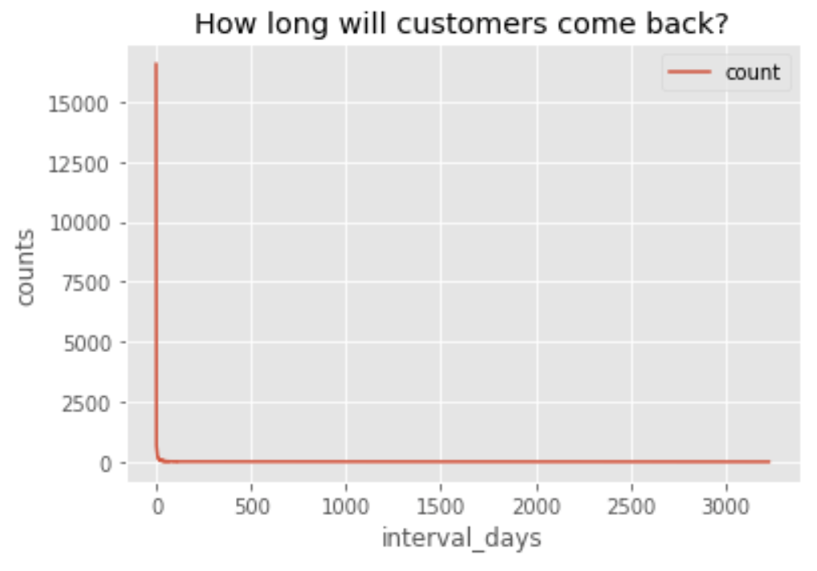
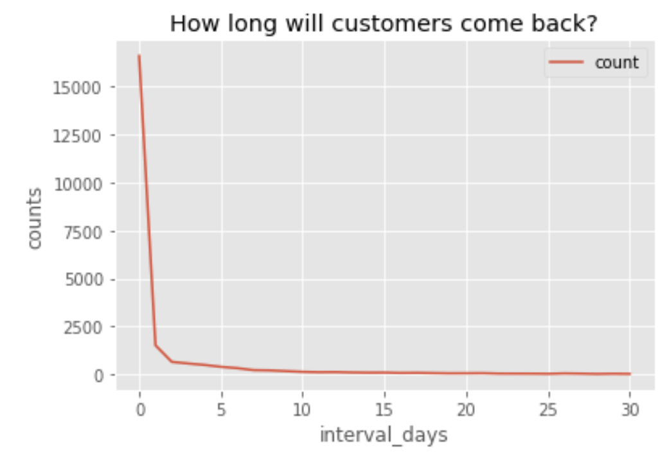
Analysis -- Retention Rate Predict
- 117,678 Customers
- 26,252 Customers came back and bought other items
- 22,969 Customers came back in 30 days

Slide 24
Analysis -- Retention Rate Predict
Objective : Predict the probability of consumer return rate in a 30 day period.
Model : Logistic Regression
Result :
 | Predict 0 | Predict 1
True 0 | 78731 | 2930
True 1 | 11318 | 4317
0: Not come back in 30 days
1: Come back in 30 days
Accuracy: 85%
Recall = TP/(TP+FN) = 28%

Slide 25
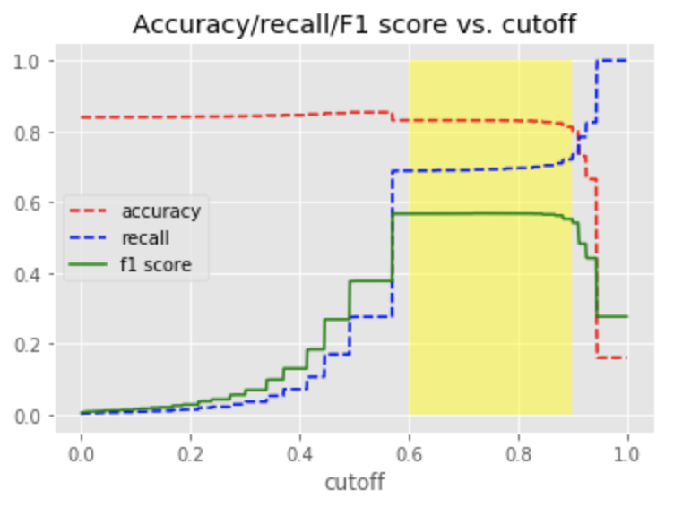
Analysis -- Retention Rate Predict
1.Cutoff

Slide 26
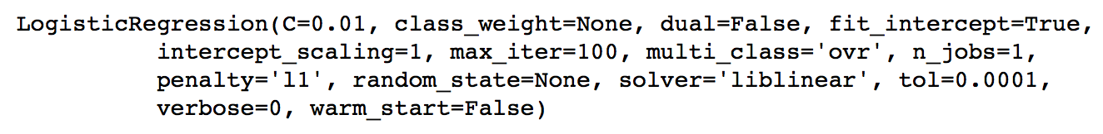
Analysis -- Retention Rate Predict
2. Up-sampling
One technique to train an imbalanced classification model is to fabricate synthesized minority class data. Up-sampling bootstraps only the minority class samples to make the major:minor ratio more balanced.
3. class_weight

Slide 27
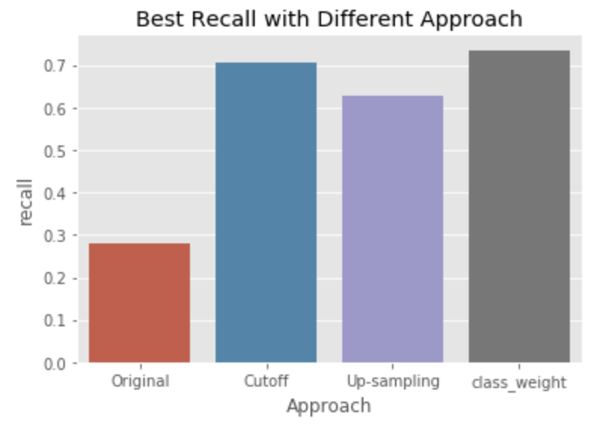
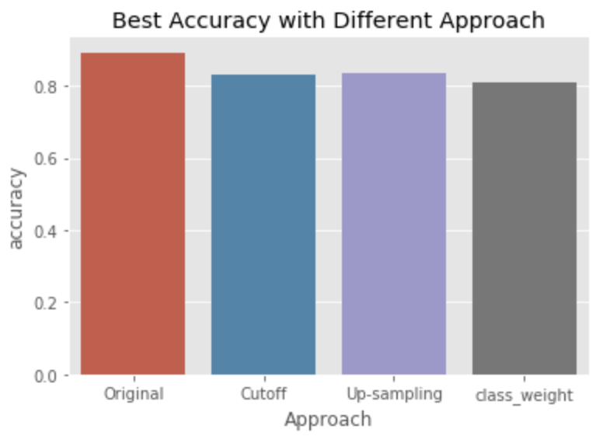
Analysis -- Retention Rate Predict

Slide 28
Recommendation
UI structures & features improvement
Especially item interface pulled by search engine on the platform.
Research on the top competitors’ design performance
Convert more random visitors to customers
Inactive customer recover
Database
Promotion policies accordingly
Reach out to customers
Bring inactive accounts back to life
Set up customer loyalty reward system
Accumulated purchase amount - wholesale customer
Accumulated purchase times - retail customer
Drive increasing activities on the active accounts

Slide 29
Recommendation
Set up a systematic filing & tracking system
Customer follow up
Customer feedback
Birthday gifts (such as store branded backpack hanging toys. For different ages)
Maintain & increase customer satisfaction rate
Research on TianMao promotion policies
Target windows
Target customer groups
Target season
Generate higher visitor traffic

Slide 30
Further Research
Further analysis with AB test on UI
Deep research on top competitors UI: page structure, graphic, promotion, product group and item links etc. Thus create systematic AB test plans
Further analysis on the 8400 accumulated sold items with NLP
Add catch more features such as age group to the item groups; Together with improved logistic regression model to form a more efficient and accurate group product recommendation system
Further analysis on customer reviews with NLP
Help determine more effective marketing approaches

Slide 31
Further Research
Further analysis into the regional features
Between east coast (top 5 provinces, 53% revenue) & western regions(30 province, 47% revenue) to drive regional expansion into the vast western market
Further analysis into city & town level sales density
Indications of group customer influences such as school clusters. Thus specific regional group marketing plan may be considered: such as the purchased backpack being delivered with store branded fashion toys (hanging on backpack) .

